Slide 1
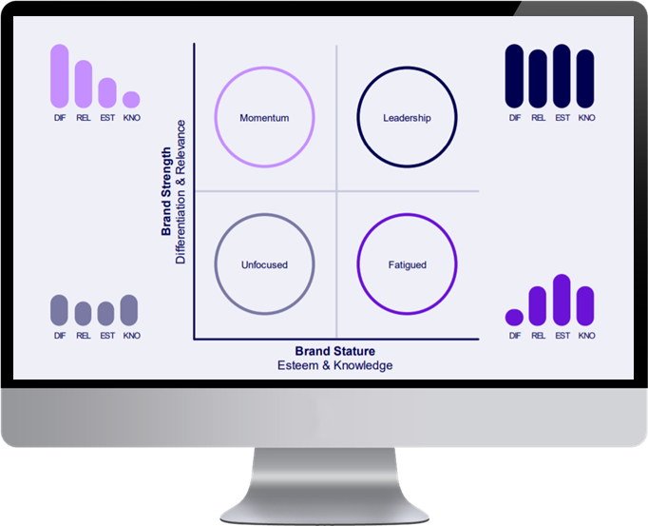
Data-driven linkable content for engagement and leads
CASE STUDY | AUSTRALIA | AUTOMOTIVE
Challenge
Mitsubishi Motors wanted to boost website authority and generate high-quality organic traffic for their "Live Outlandish" Outlander campaign. Facing stiff competition in the SUV market, they needed a unique approach to stand out and drive conversions. The objective was to increase organic keyword rankings, drive organic page views, and improve lead generation.
2 x Global Search Award Winner 2024
Approach
Leveraging the power of data-driven content marketing, Wavemaker crafted a campaign around "Australia's Secret Road Trip Hotspots." Analysing over 1.1 million data points, they identified hidden gem locations with high Trip Advisor ratings but low search volume and thus ''hidden.'' This unique content, packaged with stunning visuals and interactive maps, targeted adventure-seeking families and aligned perfectly with the "Live Outlandish" spirit.
Results
The campaign exceeded expectations, achieving 118 organic keyword rankings, surpassing the target for organic page views by 66%, and generating a 2.2% conversion rate for lead forms – 1.4 times the website average. The campaign garnered significant earned linking media exposure worth 7.5 times the project fee and drove over 51,000 unique visits to the Mitsubishi Motors website. The data-driven approach successfully boosted brand visibility, drove qualified leads, and solidified Mitsubishi Motors as an authority in the adventure-seeking market.

Slide 2
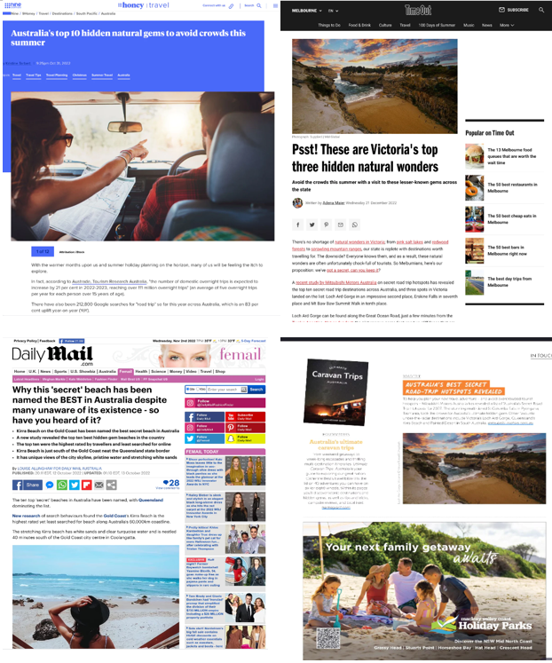
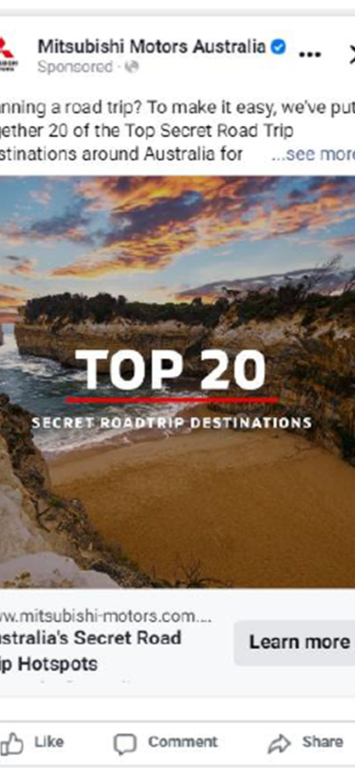
Assets and Awards
CASE STUDY | AUSTRALIA | AUTOMOTIVE
Earned linking coverage
www.mitsubishi-motors.com.au/australias-secret-road-trip-hotspots
Supporting social & native amp

