Slide 1
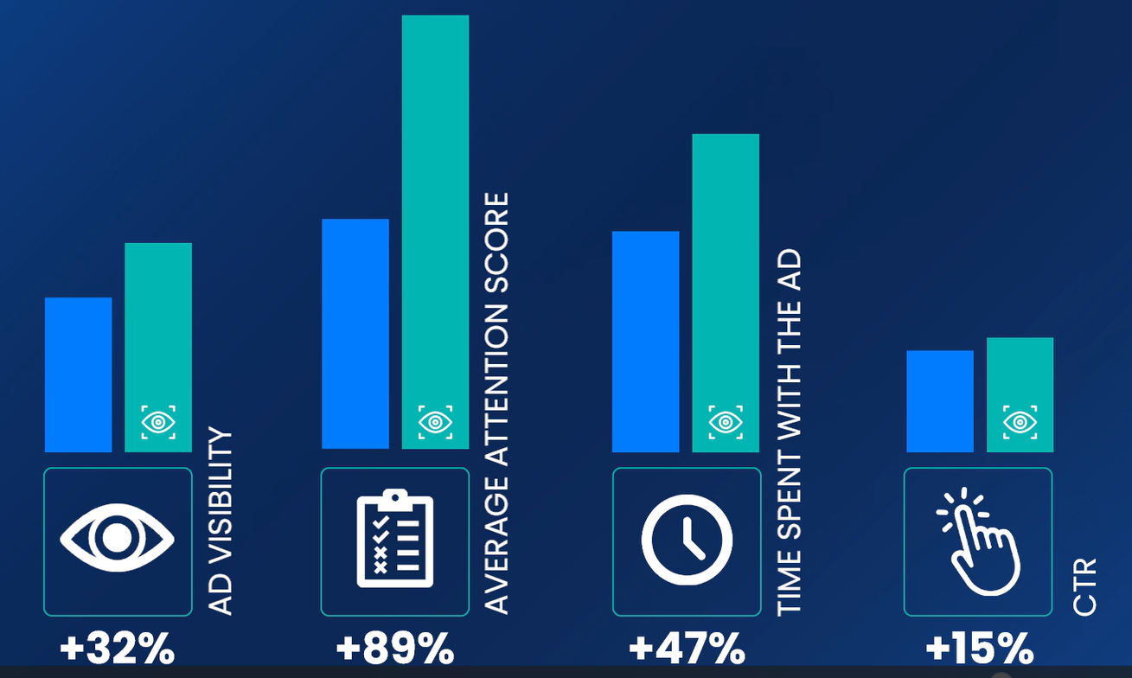
I.D.C. Holding campaign captures audience attention with support from AI and Adelaide
CASE STUDY | SOLVAKIA | FMCG
Challenge
Approach
Mindshare collaborated with I.D.C. Holding, an FMCG client, to launch a display campaign for their LINA wafers in Q4 2023. The primary objective of the campaign was to enhance the ad effectiveness in a saturated market and drive maximum traffic to the contest site while boosting online registrations.
GroupM Nexus collaborated with Adelaide to define attention as a score for the Slovak market, which served as a basis for optimizing towards the campaign’s effectiveness. The team then used Copilot's AI to optimize bids and budgets based the Adelaide attention data to drive performance.
Results
To showcase the effectiveness of the campaign, the team compared the results of the optimized line items to benchmarks from local 2023 display campaigns. The analysis revealed that the test campaign achieved an 89% higher average attention score, 47% longer time spent on ads, 32% higher ad visibility, and a 15% higher CTR. The campaign, together with other media types, achieved an above-average increase in registrations on I.D.C. Holding’s website at 143%.
“
In an environment full of distractions and influences, it was important, even necessary, for us to manage the optimization of attention. This method of optimization allowed us to create a campaign that not only attracted attention, but also brought results far beyond our expectations. Lina was not only seen, but was seen where it mattered most.
Tomáš Králik
Head of Marketing
I.D.C. Holding

