Slide 1
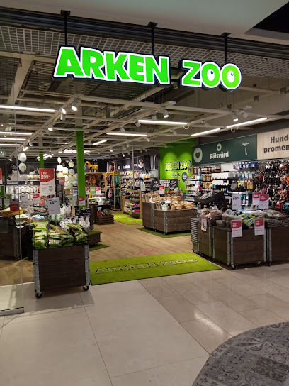
How first-party data optimized search and resulted in increased sales without extra budget
CASE STUDY | SWEDEN | FMCG
Challenge
5%
More clicks
Arken Zoo, a pet food brand in Sweden, wanted to increase sales from their website. They wanted to understand customer behaviour and leverage these insights to enhance their search strategy.
Approach
20%
More sales
The "Purr-fect Profits" campaign utilized first-party data and machine learning models with a value-based bidding setup from Google Analytics 4. The process included data cleaning, analysis, prediction score creation, and activation. Soft conversion actions were assigned values based on their contribution to final sales and imported into Google Analytics 4 and Google Ads. These platforms served as the main media channels.
Finally, an A/B test in Google Ads Experiment compared the original campaign to the new value-based bidding goals.
0%
Additional budget
Results
By utilizing first-party data and optimizing the search strategies we were able to drive higher sales without additional budget.
The success of the campaign was determined by its impact on clicks and sales. The experiment campaign generated 5% more clicks and a remarkable 20% increase in sales, all without any additional budget allocation. These impressive results pleased the Arken Zoo team.
Winner – Best Search Innovation Sweden

