Slide 1
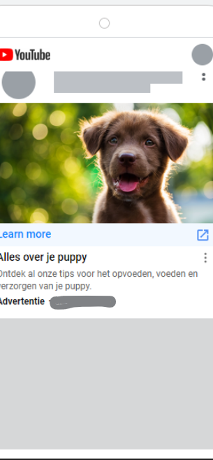
Pmax drives quality traffic to pet food site & lowers CPA
CASE STUDY | EMEA | FMCG
Challenge
A leading pet food brand wanted to expand its reach in Belgium and the Netherlands. Their goal was to move beyond traditional search audiences while driving more high-quality traffic to their website and lowering the cost per acquisition (CPA).
Approach
EssenceMediacom implemented a Performance Max (Pmax) strategy to enhance the brand’s Always On strategy. The approach involved:
Harnessing automation and machine learning: to optimize ad placements across all Google platforms and target a broader, more qualified audience.
Asset optimization: to ensure maximum relevance and engagement. Leveraged relevant search themes.
Expanding reach and targeting: across a wide range of Google networks including YouTube, display, Maps etc. Reach was refined by using audience signals to target users interested in pet food products and retargeting those who had previously shown interest.
Data-driven optimization: enabled cost-effective budget allocation while maintaining traffic quality.
Results
The campaign achieved a 6% increase in Quality Site Visits (QSVs) compared to the previous period, and 42% increase in time spent on site. This signifies a higher quality of traffic and greater interest and engagement with the content. Notably, this was achieved while reducing spend by 23%, indicating a higher efficiency of the Pmax strategy. CPA was reduced by 28% compared to the traditional search campaigns.

