Slide 1
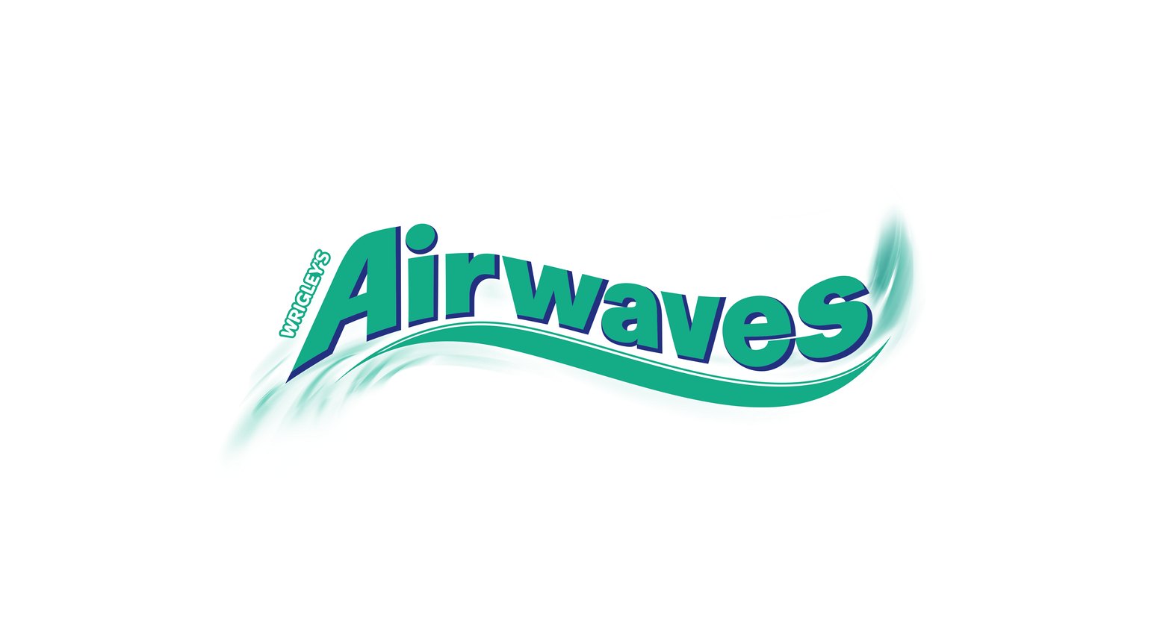
Integrating shopper data in addressable TV targeting to efficiently reach consumers and raise brand awareness
CASE STUDY | TAIWAN
13%
Challenge
Uplift in favourability
Globally, Mars wanted to drive greater effectiveness from its media investment by better use of data and digital engagement. More specifically, Mars wanted to expand its target audience and encourage existing customers to purchase more frequently by maximizing top-of-mind awareness close to the time of purchase.
Achieving these objectives was challenging. Notably, Mars doesn’t have a website in Taiwan, so is unable to measure conversions or generate 1st party data to get a true picture of its consumers.
Previously, they have built their business by investing heavily in traditional TV. However, linear is on the decline, particularly for younger audiences. So, Mars’ key challenge was to find a more efficient way to maximize awareness and drive engagement among its ideal customers.
12%
Rise in purchase intent
21%
Lift in brand awareness among those aged 18-24
“
With the media environment changing, CTV is becoming a new trend and a new opportunity to reach consumers, especially after the pandemic. GroupM Nexus and EssenceMediacom leveraged their proprietary tools to plan the campaign and find the best budget allocation to maximize media efficiency. Incorporating the app data was a genius idea that helped us to engage real customers – both existing and potential ones.
Paul Hsu
Mars Wrigley Asia Media Head

Slide 2
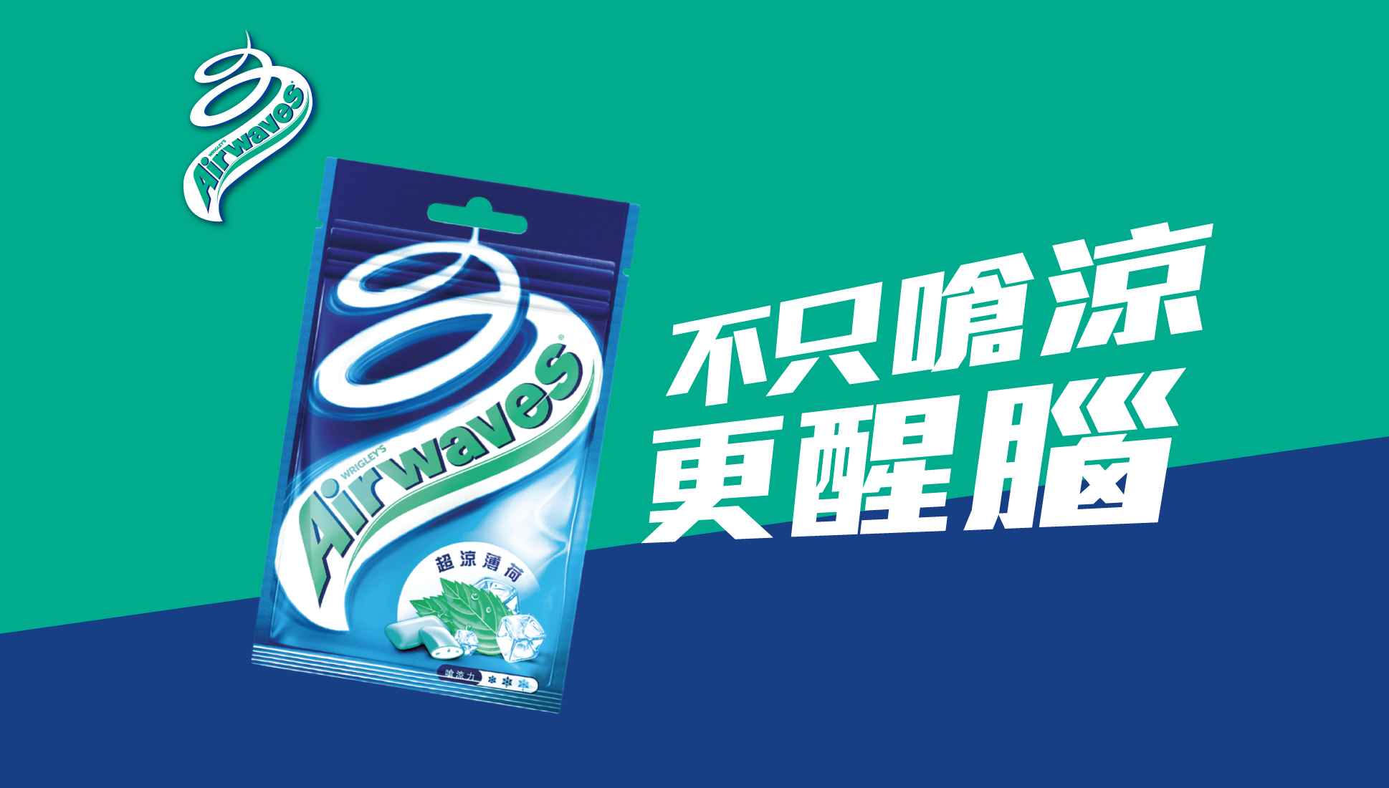
Approach
In Taiwan, there is a unique system relating to purchase receipts. Every time a person purchases goods, they get a receipt. Every two months, the government does a lucky draw from those receipts, which encourages people to collect and keep their receipts. An app has been created to digitize and store these receipts. By working with the app developers, we have access to their data and have insight into what each device ID owner buys. This enabled us to find past consumers of Mars’ products and identify potential ones. Mars particularly wanted to strengthen its reach among consumers aged 18-24 and influence their preference for their products.
Integrating these insights with GroupM Nexus’ proprietary audience activation platform, Audience Planner, we could precisely target real consumers of Mars’ products at a household level, which has never been done on linear TV.
Results
The campaign achieved strong results, including a 96% completion rate, which is 1.07x higher than the benchmark of past campaigns (90%).
GroupM Nexus partnered with Kantar to understand the effect of the campaign on brand metrics via a control vs. exposed study methodology. It revealed a 13% increase in brand favourability and a 12% rise in purchase intent among those who saw the ad.
Crucially, the campaign achieved a 21% lift in brand awareness among those aged 18-24, which is more than 3x higher than the other audience groups.
The campaign also achieved significant success in changing consumer perception, with a 13% uplift in “meets needs better than other brands”.

