Slide 1



Addressable TV creates incremental reach among a younger audience
CASE STUDY | FMCG | THAILAND
24%
Boonthavorn is a leading home improvement retail chain in Thailand that caters for all your household needs from home appliances to hardware. Younger audiences who are setting up their home or renovating for the future are a prime audience for Boonthavorn. However, these audiences are becoming harder to reach especially on traditional linear TV as they prefer to watch their favourite programs through streaming platforms.
In Thailand, TV ads are still the primary platform for generating positive opinions of brands, but the environment is increasingly fragmented.
For Boonthavorn’s new campaign, showcasing that it has everything needed to “Live your way”, it needed an innovative way to maximise awareness among its core audience.
Uplift in brand consideration
26%
Uplift in positive opinion
24%
Uplift in likelihood to recommend
Approach
Boonthavorn partnered with GroupM Nexus to gain a single point of access to the entire addressable TV ecosystem. The goal of the campaign was then to add incremental reach to the linear TV plan to combat any declining reach. GroupM tools were used in a two-stage process:
The reach and frequency goals were mapped by Wavemaker using mScreen, which calculated the allocation of investment to maximise the specific goals.
Using Audience Planner, powered by Experian data, a bespoke segment was built consisting of people aged 20-49 who were likely to spend on housing, household goods and services, leisure and recreation. Audience Planner then identified 189 postcodes in Bangkok and urban areas with those with a new house, who love to decorate their house and have their own style.

Slide 2

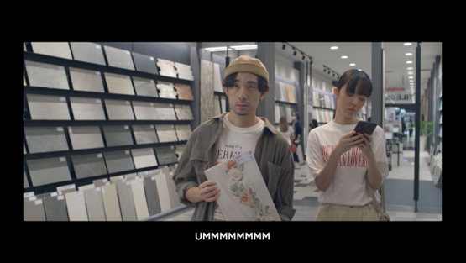
Results
The shift in viewing behaviours among younger audiences toward streaming their favourite show was validated by the successful outcomes of the campaign. The campaign had a significant uplift in consideration towards choosing Boonthavorn as a homeware brand with an uplift of 24%. This was observed particularly for 20-49-year-olds.
There was an increase in brand reputation – positive opinion rose by 26% and likelihood to recommend increased by 24/%.
There was also a 45% uplift in Boonthavorn being perceived as a brand that represents respondents’ own style, suggesting successful campaign message delivery. To understand the effect of the campaign on brand metrics, GroupM Nexus partnered with Kantar Lightspeed to conduct a brand lift study using control vs. exposed study methodology.
“
Our campaign was built to target people that were consumers aged 20-49 who were likely to spend on housing, household goods and services, leisure and recreation. GroupM Nexus demonstrated through planning that they could effectively reach this audience and we are very pleased with the campaign outcomes.”

Slide 3


makeO toothsi shifts to addressable TV to drive purchase intent among affluent audience
CASE STUDY | INDIA
Challenge
makeO toothsi, a makeO brand, is revolutionizing the way Indians get smile makeovers, by providing teeth alignment solutions that are more affordable and accessible through cutting edge invisible aligner technology.
The increase in disposable income among the middle class has led to higher spending on beauty and personal care products that will enhance their appearance, including their teeth. For this cohort, having straight, aligned teeth is perceived as a sign of confidence, attractiveness and happiness.
Meanwhile, the growth of e-commerce in India has made it easier for brands to reach a wide audience. For consumers, online shopping provides convenience, variety, and the ability to compare products before purchasing.
makeO toothsi therefore wanted to raise awareness and desire for its clear teeth aligners among a beauty-conscious, high-income audience, and drive purchase intent.
“
Working with GroupM Nexus has enabled makeO toothsi to effectively reach our audience at scale more efficiently than ever before to produce some excellent results.”
Shuchita Wadhwa
Head of Marketing, makeO

Slide 4
makeO toothsi shifts to addressable TV to drive purchase intent among affluent audience
CASE STUDY | INDIA
Challenge
makeO toothsi, a makeO brand, is revolutionizing the way Indians get smile makeovers, by providing teeth alignment solutions that are more affordable and accessible through cutting edge invisible aligner technology.
The increase in disposable income among the middle class has led to higher spending on beauty and personal care products that will enhance their appearance, including their teeth. For this cohort, having straight, aligned teeth is perceived as a sign of confidence, attractiveness and happiness.
Meanwhile, the growth of e-commerce in India has made it easier for brands to reach a wide audience. For consumers, online shopping provides convenience, variety, and the ability to compare products before purchasing.
makeO toothsi therefore wanted to raise awareness and desire for its clear teeth aligners among a beauty-conscious, high-income audience, and drive purchase intent.
Approach
While makeO toothsi was a veteran of YouTube advertising, performance on the platform had plateaued. makeO toothsi needed a different way to reach new and relevant audiences. GroupM Nexus’ Advanced TV solution was selected for its ability to target custom audiences at the household level across premium broadcast channels such as lifestyle, music, English movies and infotainment, which are relevant for makeO toothsi.
Using Audience Planner, makeO toothsi’s audience was identified as people aged 22-45 living in seven cities in India. The campaign was then launched with two creatives – a 20 sec edit ran for two weeks to establish the message in consumers’ minds, then the 10 sec edit ran for a further two weeks to maximise frequency and achieve greater recall. The creatives strategically featured Indian cricket star Virat Kohli and his wife Bollywood star Anushka Sharma, to capture attention and promote recall.

Slide 5
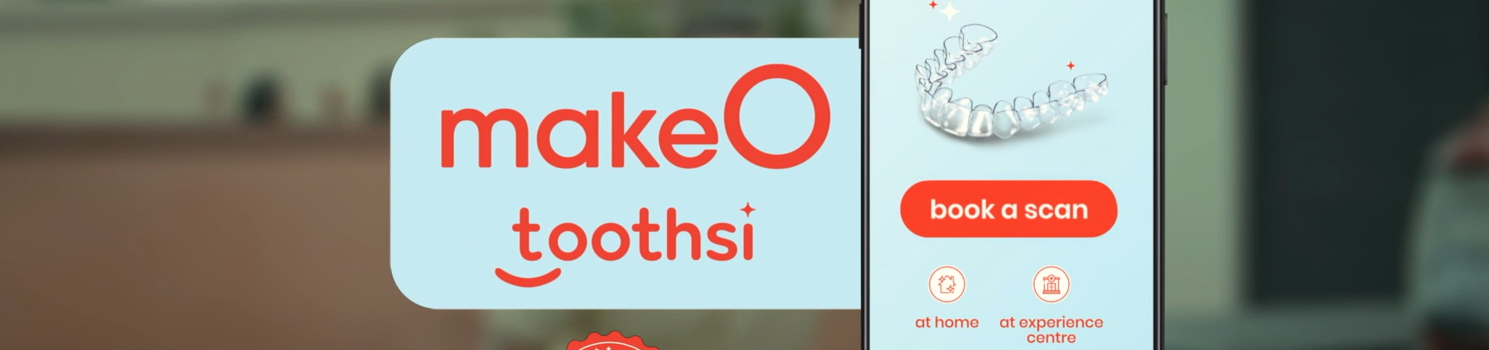




Approach
While makeO toothsi was a veteran of YouTube advertising, performance on the platform had plateaued. makeO toothsi needed a different way to reach new and relevant audiences. GroupM Nexus’ Advanced TV solution was selected for its ability to target custom audiences at the household level across premium broadcast channels such as lifestyle, music, English movies and infotainment, which are relevant for makeO toothsi.
Using Audience Planner, makeO toothsi’s audience was identified as people aged 22-45 living in seven cities in India. The campaign was then launched with two creatives – a 20 sec edit ran for two weeks to establish the message in consumers’ minds, then the 10 sec edit ran for a further two weeks to maximise frequency and achieve greater recall. The creatives strategically featured Indian cricket star Virat Kohli and his wife Bollywood star Anushka Sharma, to capture attention and promote recall.
Results
The campaign was delivered to 11.25 million households alongside premium broadcast content across smart TV’s and set-top boxes. It achieved a 93% completion rate. GroupM Nexus also partnered with Kantar to conduct a brand lift study, assessing performance across key metrics.
Among those exposed to the makeO Toothsi advert, there was an 85% lift in consideration, 76% rise in positive opinion, 38% increase in likelihood to recommend the brand and 59% purchase intent in the next 6 months.
Respondents were also enthused to take action after seeing the advert, with 71% stating that they will download the app and book and scan, and 56% will sign up for the video consultation.
GroupM Nexus’ flagship product delivering the most premium broadcaster VOD inventory on the big TV screen
Independent brand uplift study powered by Kantar Profiles

