Slide 1
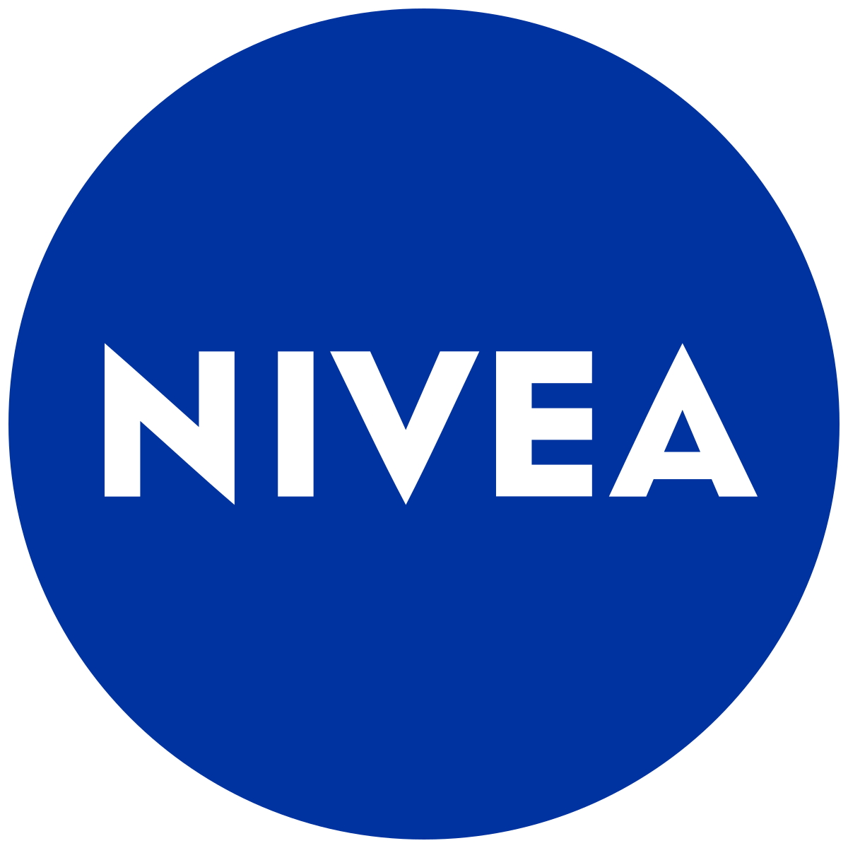
TikTok campaign boosts awareness of NIVEA Q10
Simone’s video went near-viral and amassed just under 850 thousand views - creating huge exposure for the brand and the product in question
FMCG | UK
£0.01
£0.71
CPE
CPC
Challenge
£5.74
To drive awareness of the NIVEA Coenzyme Q10 Energy Eye Cream.
CPM
Approach
We ran a 4-week campaign on TikTok. The campaign was activated using two micro-influencers from the beauty/lifestyle vertical and was further amplified with paid activity, driving traffic to Superdrug
Results
It was clear that the Influencers on this campaign had a genuine love for the product with Amelia in particular featuring it in an organic Get Ready With Me style video that garnered just under 10 million views
Our paid results were outstanding especially considering this was our first solely NIVEA TikTok campaign. Highlights included over 4 million engagements, over 50 thousand link clicks and a CPM of £5.74
50,072 Clicks
Up 209% of guaranteed

