Slide 1






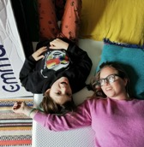
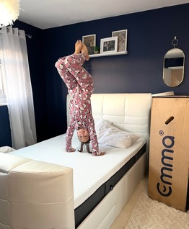
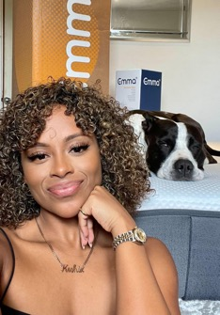

Driving sales for Emma using influencers
Retail | UK
Results
Throughout the campaign we created over 390 social posts, achieving over 6,000 purchases.
Overview
£3.49
6.30
We worked with Emma to generate sales of Emma mattress’ during the key sales periods throughout 2021 and 2022 to drive sales.
Total CPC
ROI
£3,437,528
Approach
To achieve this, we onboarded 72 influencers - across lifestyle, parenting, interior, wellness, fashion, comedy verticals - to post a combination of Instagram Posts, Reels and Instagram Stories, also TikTok. The influencers used unique discount codes to encourage their followers to purchase an Emma Mattress.
Through paid media we ran a pure prospecting campaign, activating with both Facebook, Instagram Feed and Instagram Story ad placements, with the copy reflecting the various sales offers over the duration of 2021 Q4.
Revenue

